Slide 1
Exploratory Data Analysis
Mini Project
Name: Sathvik Satheesh
Batch: Jan 2020

Slide 2
DATA SUMMARY
164 countries
651 clubs
17194 players
134 highly rated players
Elder player age was 45 and only person
Youngest players age was 16 and 42 players where there
Most players are from England

Slide 3
Top RATED PLAYERS
L MESSI
Rating: 94
Nationality: Argentina
Club: Barcelona
Age: 31
Position: RF

Slide 4
Top RATED PLAYERS
CRISTIANO RONALDO
Rating: 94
Nationality: Argentina
Club: Portugal
Age: 33
Position: ST

Slide 5
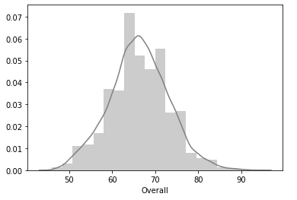
Distribution plot

Slide 6
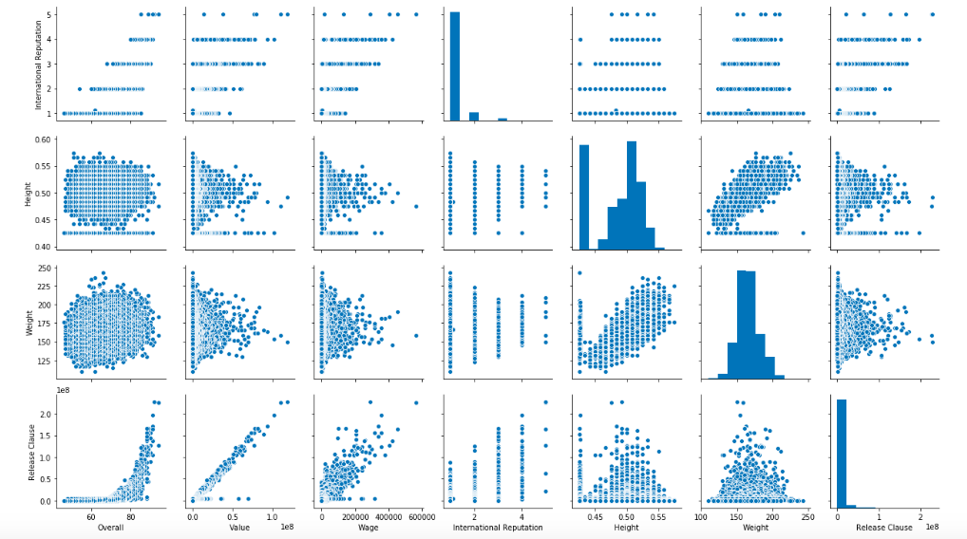
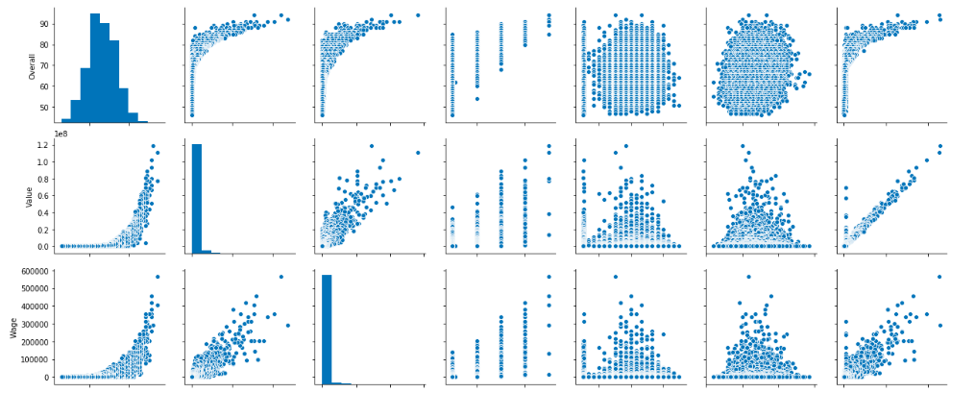
PAIR PLOT

Slide 7
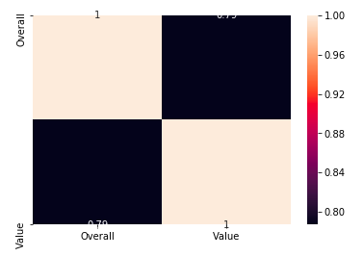
cORRELATION BETWEEN THE oVERALL RATING AND VALUE

Slide 8
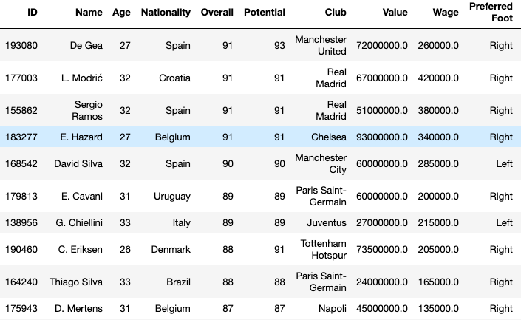
Top rated 20 players whose contract is ending in 2020

Slide 9
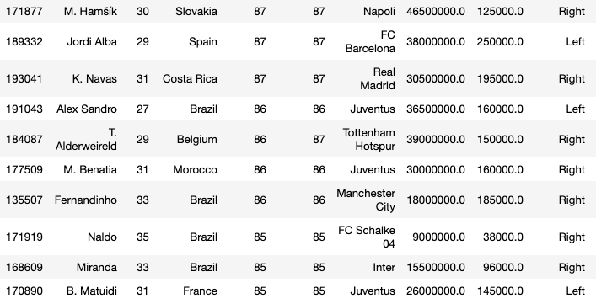
Top rated 20 players whose contract is ending in 2020

